Slide 1
College Selection Model
By TAZY GROUP - Tyler, Anwar, Zac, Yvonne

Slide 2
Agenda
Team Introduction
Project Overview
Data Analysis and Preparation
General Information
Develop College Selection Model
Statistical Analysis
Evaluation & Findings
Model Demonstration
Conclusion

Slide 3
Project Overview
Prince George’s County Board Request
Intended Audience: junior year high school students and their parents
Research Question: Which universities or colleges should “typical” junior year high school students from Prince George’s County public schools consider attending, and what institutional characteristics should they take into consideration when choosing?
Data Source
US Department of Education’s College Scorecard Dataset

Slide 4
Data Analysis and Preparation
Determined the domain
50 states + DC
Created Target Data Set
Colleges awarding Associate, Bachelor, and Graduate degrees
Colleges that are currently operating
Colleges that are not under heightened cash monitoring
Colleges that are not exclusively for graduate students
Added descriptive text for columns that had coded values
Data Reduction
Reduced from 1779 variables to 173 variables
Reduced from 7593 records to 3824 records

Slide 5
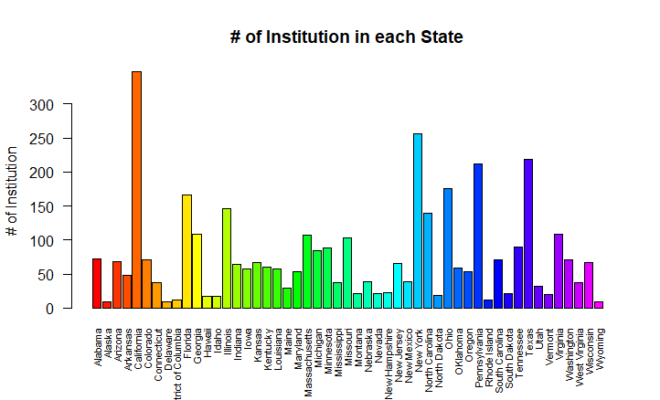
General Information - # of Colleges by Region
There are 3824 colleges, with California having the most at 347; New York the next highest at 256, and Delaware and Alaska having the least, 9 colleges

Slide 6
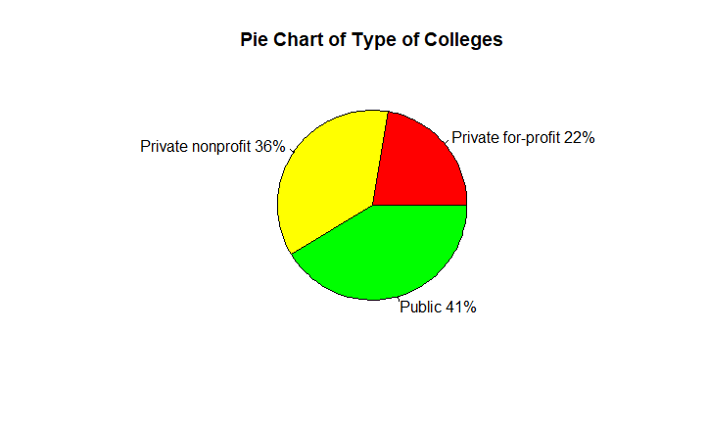
General Information - Type of Colleges
There are 1581 Public, 1388 Private nonprofit, and 855 Private for-profit colleges

Slide 7
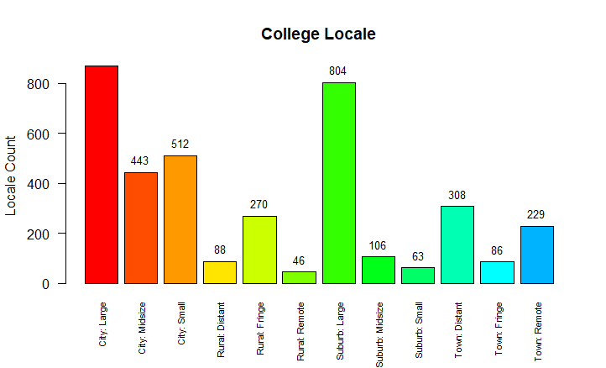
General Information - College Locale
Most colleges are located in large cities.

Slide 8
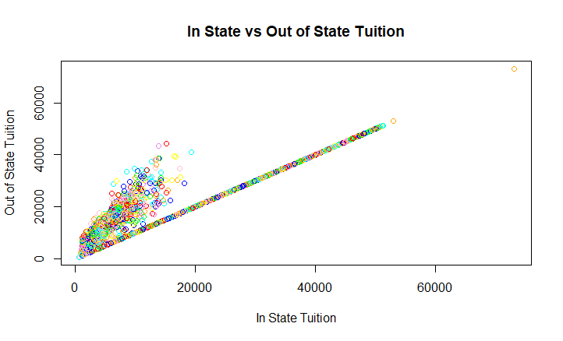
General Information - Tuition and Fees
The range of in-state and out-of-state tuition falls between $590 and $73,,132. There is a positive correlation between in-state tuition and out-of state tuition. As in-state tuition increases, out-of-state tuition increases

Slide 9
Develop College Selection Model
The College Selection Model is made up of 3 components
Financial Stability Score
Academic Success Score
Persona Information (input from parent/student)
Other output information (e.g. average age of entry, admission rate)
Persona data entered will be used to identify the top 5 colleges that matches the student/parent profile and will predict the student’s financial stability and academic success

Slide 10
Statistical Analysis - Financial Stability
The variables chosen as the best indicators of student financial stability are:
Percent of students who defaulted or failed to meet specified conditions within two (2) year and three(3) years of receiving their loan
Average earnings of students 10 years after graduating
Median debt of students who completed their degree
In state tuition and out of state tuition costs and fees
To confirm that we had chosen the best indicators, we use the plot function to verify the relationship between the variables

Slide 11
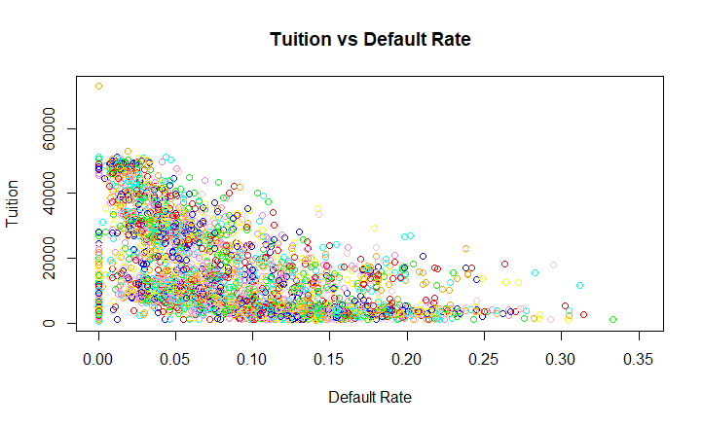
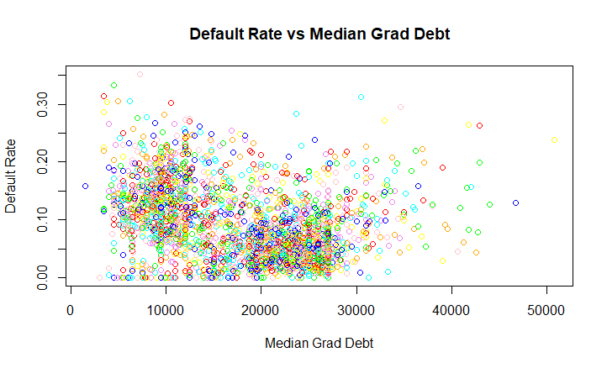
Statistical Analysis - Financial Stability (cont)
As default rate increases, tuition decreases As graduate debt increases, default rate increases

Slide 12
Statistical Analysis - Academic Success
The variables chosen as the best indicators of academic success are:
First-time full-time student retention rate
First-time full-time completion rate
Percentage of students that withdrew from original institution within 3 years
Proportion of full-time faculty staff
To confirm that we had chosen the best indicators, we use the plot function to verify the relationship between the variables

Slide 13
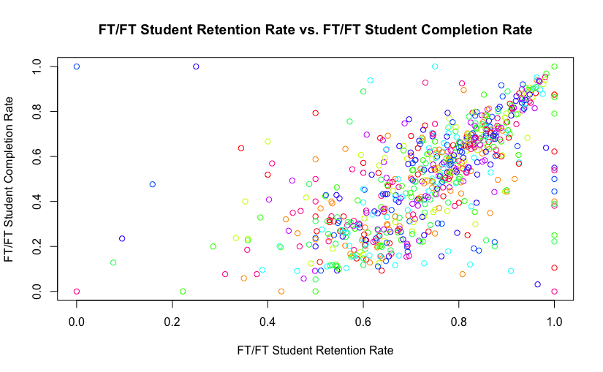
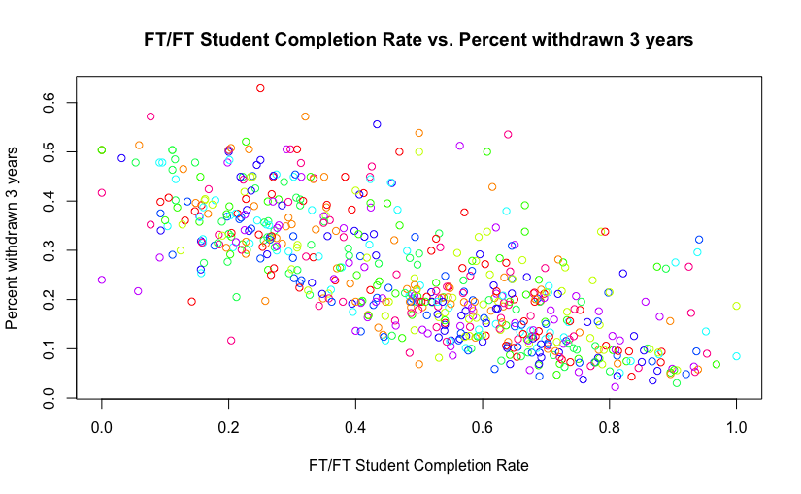
Statistical Analysis - Academic Success (cont)
As retention rate increases, completion rate increases
As completion rate increases, percent withdrawn decreases

Slide 14
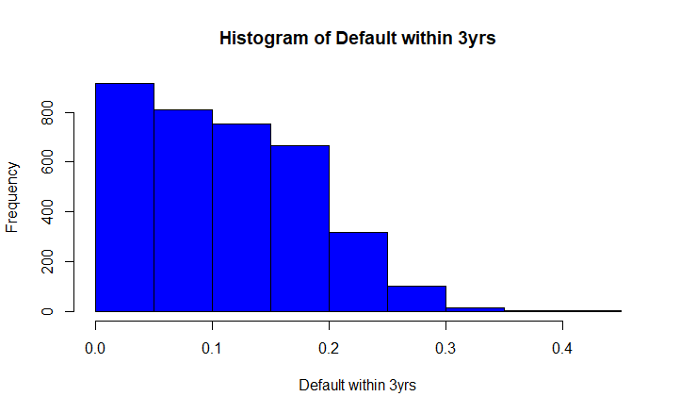
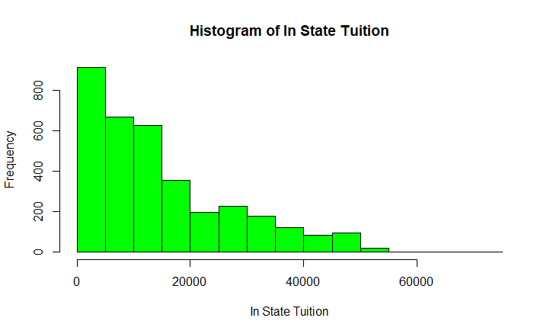
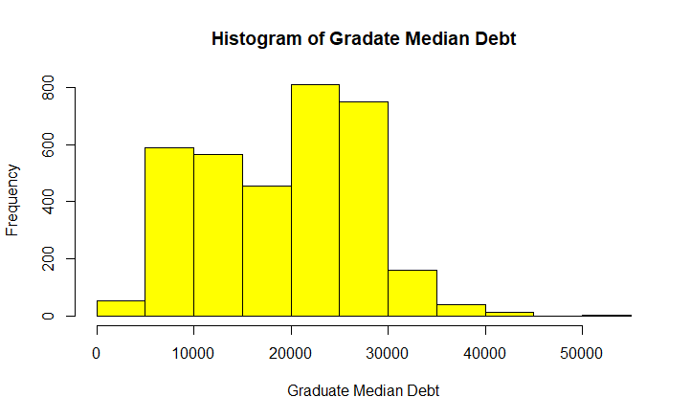
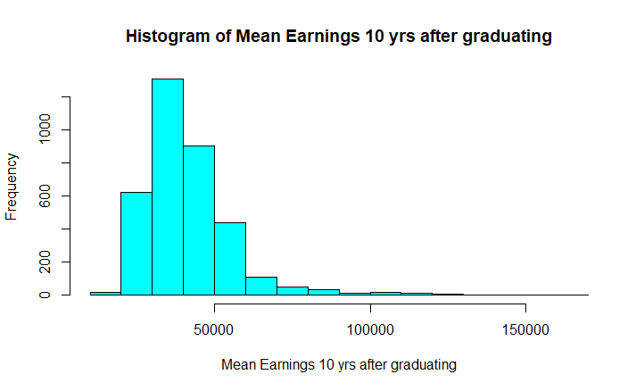
Statistical Analysis - Financial Stability Superscore
For each of the variables, calculate the mean, standard deviation, z-scores. Then sum the z-scores to get the Superscore

Slide 15
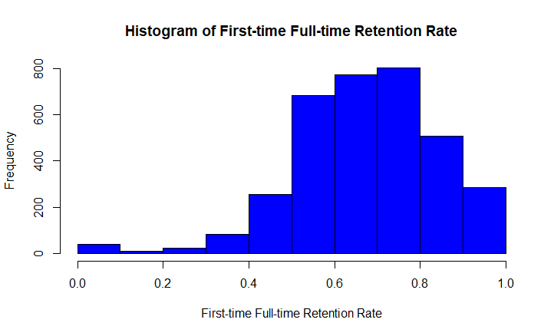
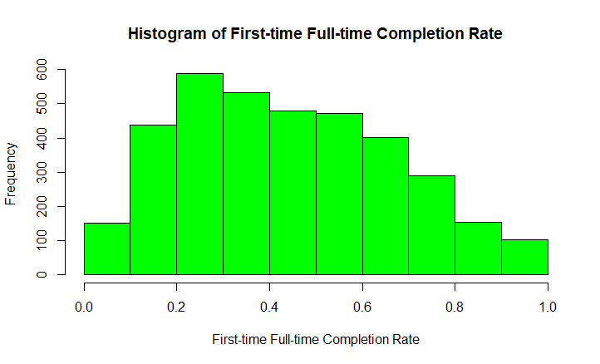
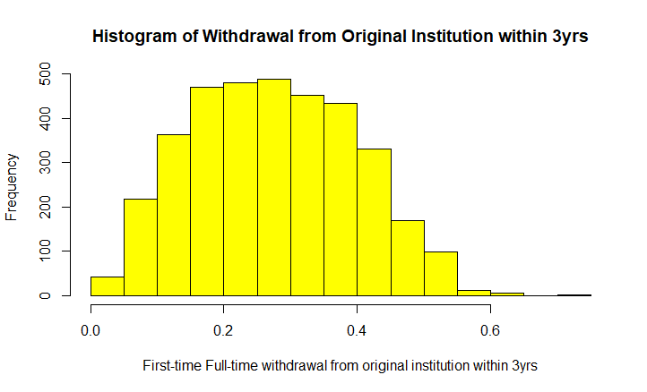
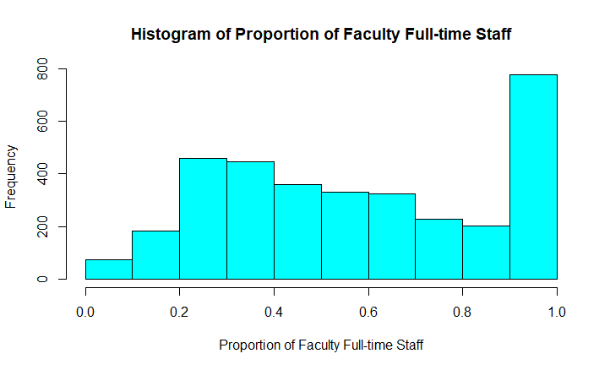
Statistical Analysis - Academic Success Superscore
For each of the variables, calculate the mean, standard deviation, z-scores. Then sum the z-scores to get the Superscore

Slide 16
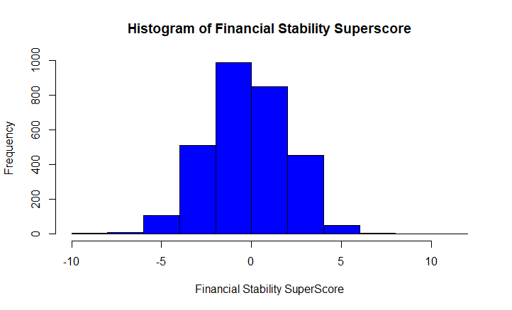
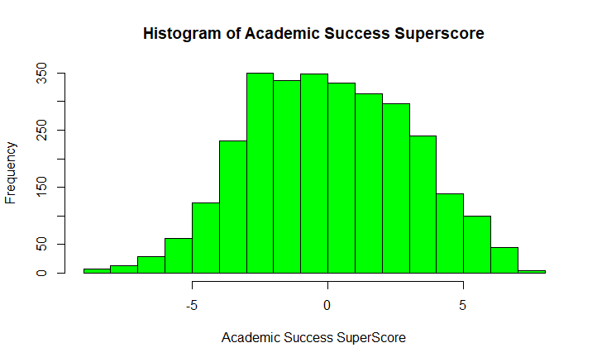
Evaluation & Findings - Superscores
Financial Stability ranking ranged from -8.5 to 10.5
Academic Success range -9 to 7.2

Slide 17
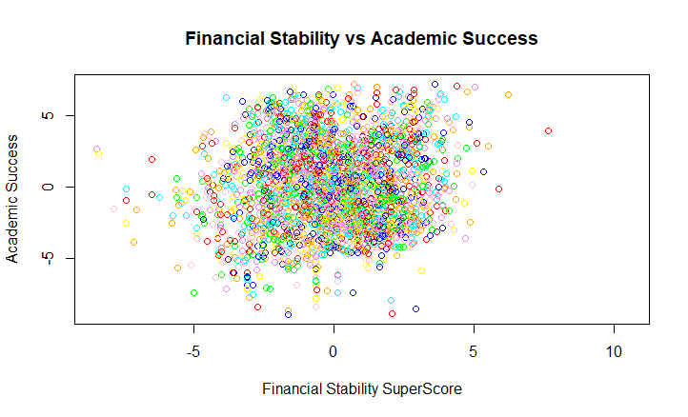
Evaluation & Findings - Financial Stability vs Academic Success
Verified that there is a relationship between financial stability and academic success. As Financial Stability increases, Academic Success increase

Slide 18
Model Demonstration for John Brown
Persona Details: https://docs.google.com/document/d/1ccsPyEc9YnceZBcZb0yX7EOTh2copYjGewDyxH9hqgc/edit?ts=5a246a99
INSTNM | CITY | TUITIONFEE_IN | TUITIONFEE_OUT | LOCALE_DESC | ST_FIPS_DESC | CCSIZSET_DESC | FS_SuperScore | AS_SuperScore
SUNY at Binghamton | Vestal | 9053 | 22173 | Suburb: Midsize | New York | Four-year, large, highly residential | 4.055413734 | 4.818931052
SUNY Polytechnic Institute | Utica | 7759 | 17609 | Suburb: Midsize | New York | Four-year, small, primarily residential | 3.838461839 | 0.582253838
SUNY Maritime College | Throggs Neck | 7809 | 17659 | City: Large | New York | Four-year, small, highly residential | 3.807624004 | 2.951446052
SUNY College at Geneseo | Geneseo | 8113 | 17963 | Town: Distant | New York | Four-year, medium, highly residential | 3.561113093 | 3.553297418
Stony Brook University | Stony Brook | 8855 | 23935 | Suburb: Large | New York | Four-year, large, highly residential | 3.203551066 | 3.734727563

Slide 19
Model Demonstration for Mary Jane
Persona Details https://docs.google.com/document/d/1ccsPyEc9YnceZBcZb0yX7EOTh2copYjGewDyxH9hqgc/edit?ts=5a246a99

Slide 20
Model Demonstration for Mark Lucas Brown
Persona Details https://docs.google.com/document/d/1ccsPyEc9YnceZBcZb0yX7EOTh2copYjGewDyxH9hqgc/edit?ts=5a246a99

Slide 21
Model Demonstration for James Doe
Persona Details https://docs.google.com/document/d/1ccsPyEc9YnceZBcZb0yX7EOTh2copYjGewDyxH9hqgc/edit?ts=5a246a99

Slide 22
Conclusion

Slide 23
Q&A
Open for Questions

